Slide 1
Artists Protest
Immigration Policies:
A Brief History
Susan Noyes Platt, Ph.D.
“Art and Immigration Policy”
John Jay School of Criminal Justice
April 11, 2018

Slide 2
1875 Page Law and 1882 Chinese Exclusion Act
First Federal Regulations on Immigration
Tool to define “American” began with with exclusions by race, gender, and class
“Legalized restriction, exclusion and deportation of immigrants considered to be threats to the US for first time. “ Established inspection, documentation
Regulation in hands of immigration officials, not the courts.

Slide 3
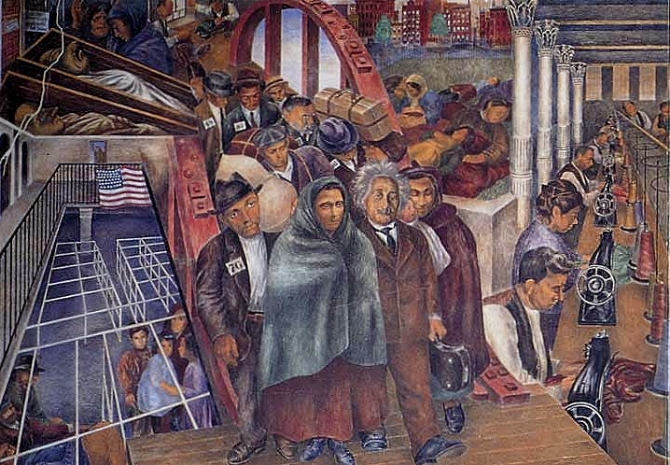
Ellis Island Near New York City 1892 – 1954 mainly processing immigration
8 million immigrants passed through: one third of current US population traces
their ancestry to Ellis Island
Ben Shahn
Sacco and Vanzetti
1924 immigration restrictions
began by quota
to restrict Southern and
Eastern Europeans
Banned Arabs, Asians, Africans

Slide 4
Angel Island Immigration Station
San Francisco opened in 1910 closed in 1940 processed mainly Chinese, 1882 laws and 1924 allowed only Chinese merchants with an affidavit from a white man saying they had never done manual labor. 90 percent of Chinese immigrants had false identities:
“paper marriages” “paper children”
“paper husbands” immigrants coached before they left China

Slide 5
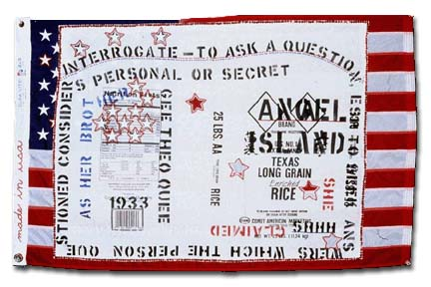
Flo Wong
made in usa:
Angel Island Shhh, 2000 to present,
one of 22 on burlap rice bags
sewed on flag

Slide 6
Executive Order 9066
Issued by President Franklin Roosevelt on February 19, 1942, this order authorized the evacuation of all persons deemed a threat to national security from the West Coast to relocation centers further inland. It set in motion the forced removal and imprisonment of all people of Japanese ancestry (citizens and non-citizens alike) living on or near the West Coast.
Hours after Dec 7 bombing of Pearl Harbor, 1941
FBI rounded up Japanese community leaders and froze their assets
Total internments of Japanese Americans in California, Washington, Oregon 117,000 people including 17,000 children under 10, as well as several thousand elderly and handicapped. 70,000 were citizens

Slide 7
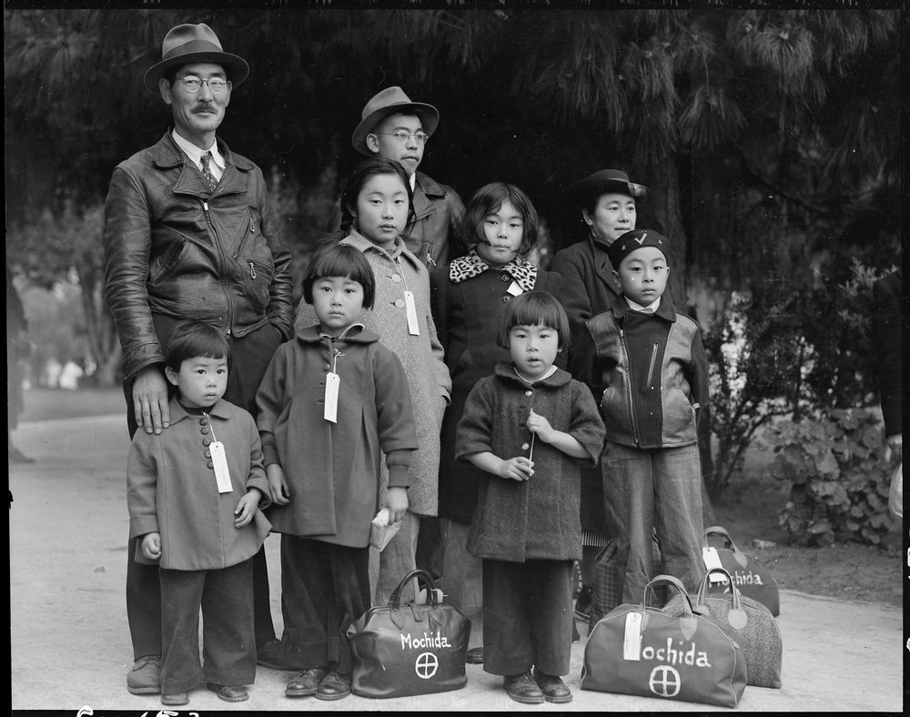
Dorothea Lange photographs rediscovered in National Archives 2006: Now on display at the International Center for Photography NYC
Mohida Family

Slide 8
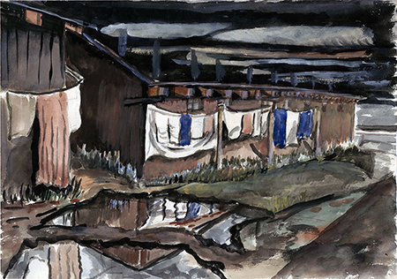
Takuichi Fujii
Interned 1942-1945
Puyallup and Minidoka
Takuichi Fujii Puyallup Laundry After the Rain

Slide 9
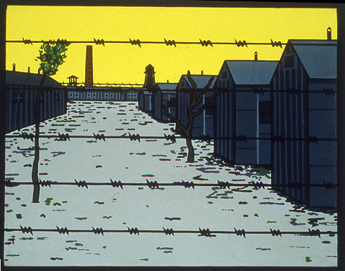
Roger Shimomura Minidoka Japanese Detention Camp World War II “American Diary” based on Grandmothers Diary
Roger interned at age 3 in 1941

Slide 10
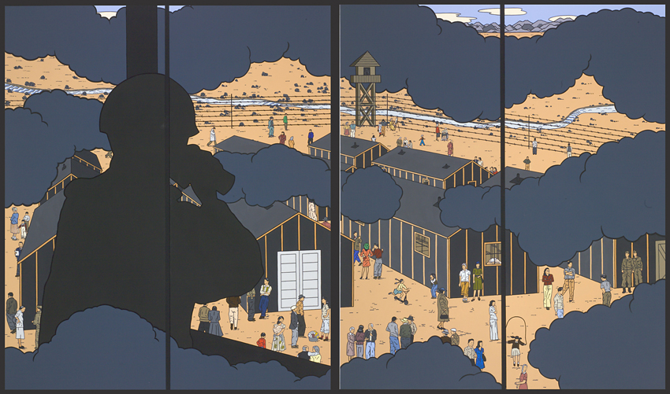
Roger Shimomura American Infamy no 2, 2006
Connecting World War II Japanese Detention
and today 16 feet high 10 feet long

Slide 11
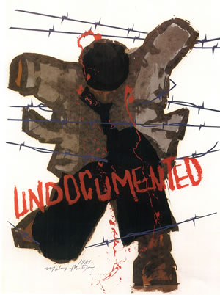
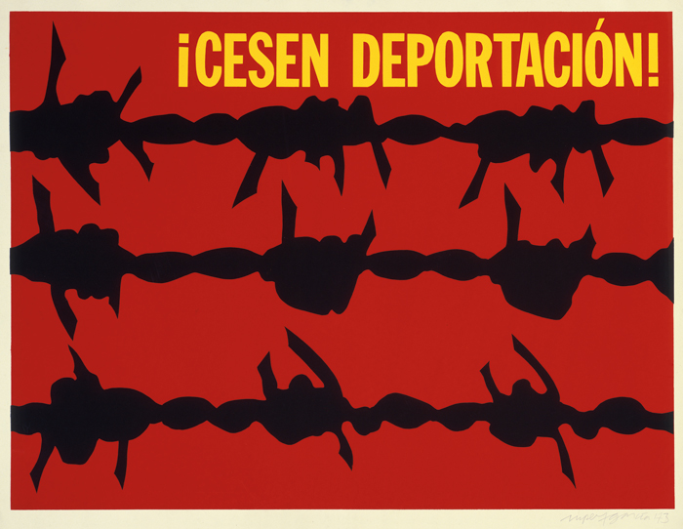
1965 Immigration act applied quotas to Latin America for the first time leading to undocumented migration of workers from the South
Malaquias Montoya Undocumented 1980
Rupert Garcia 1973

Slide 12
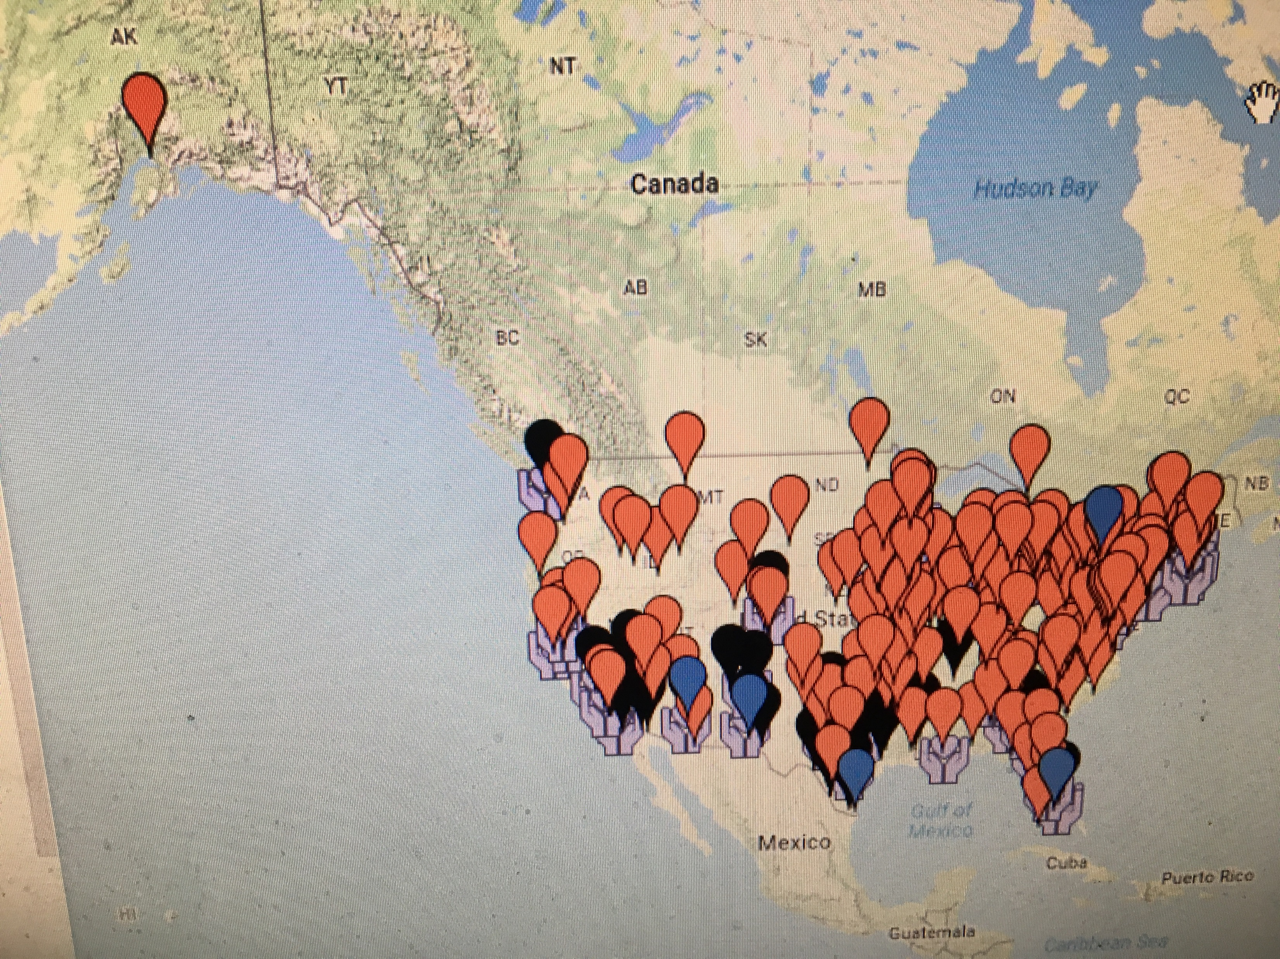
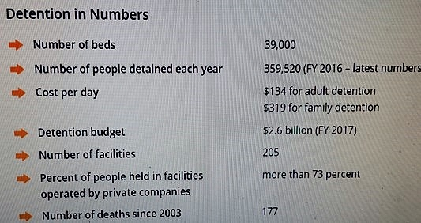
USA Patriot Act 2001
“Uniting and Strengthening America by Providing Appropriate Tools Required to Intercept and Obstruct Terrorism.” permitted long term detention of non citizens without a hearing
Endisolation.org
Detentionwatchnetwork.org

Slide 13
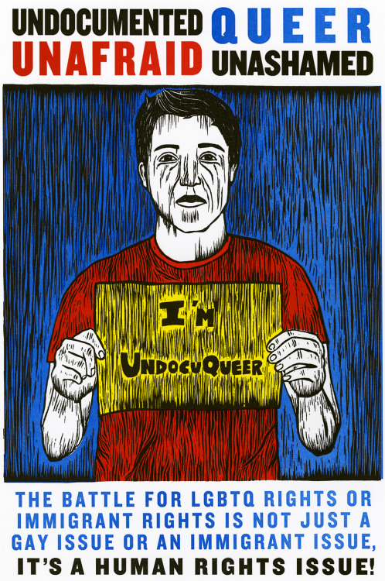
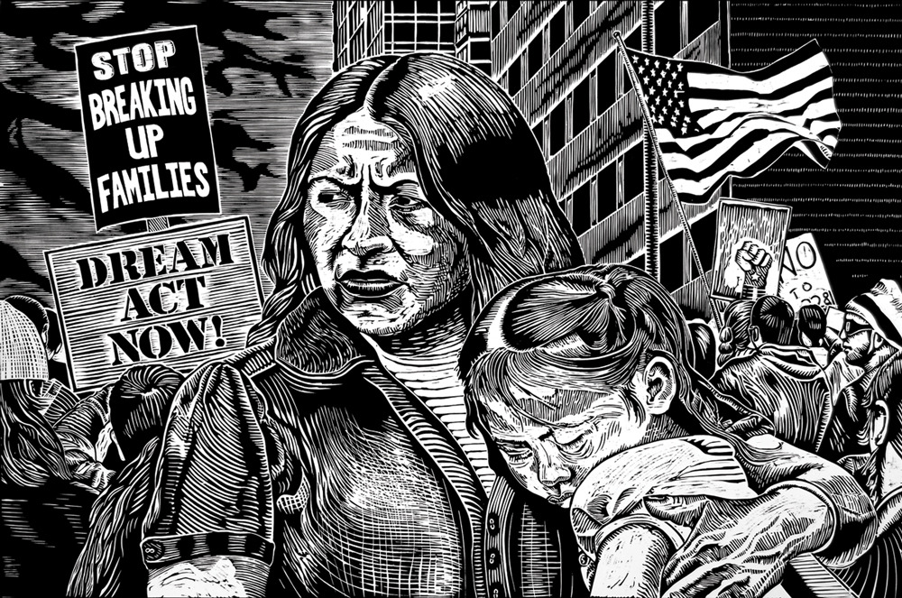
Migration Now Portfolio 2012
40 prints addressing migration migrationnow.com by Just Seeds/ CultureStrike
Raul Deal
Felipe Baeza

Slide 14
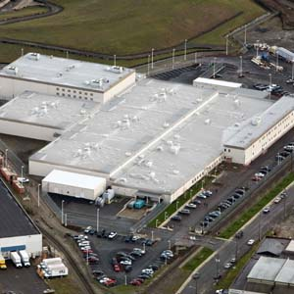
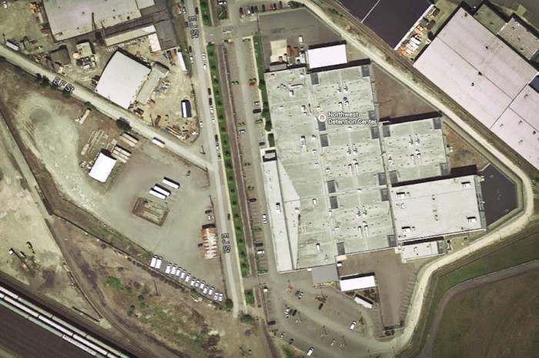
The Northwest Detention Center, Tacoma opened in 2004

Slide 15
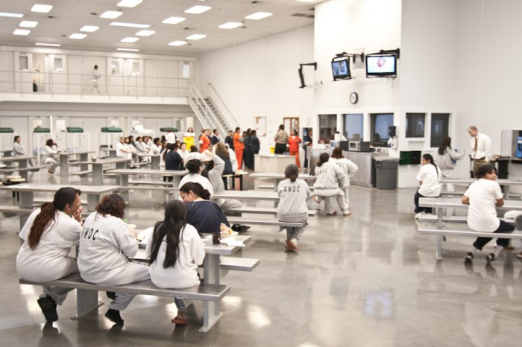
Inside the Northwest Detention Center photograph by Alex Stonehill from the Globalist
Run for Profit by GEO
In contract with ICE
Over 1500 beds
Paid $1. a day for work
Little recreation
Minimal medical treatment

Slide 16
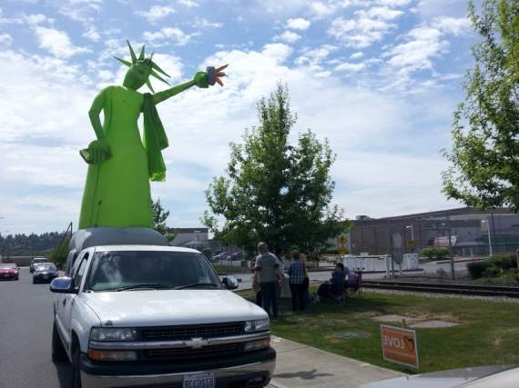
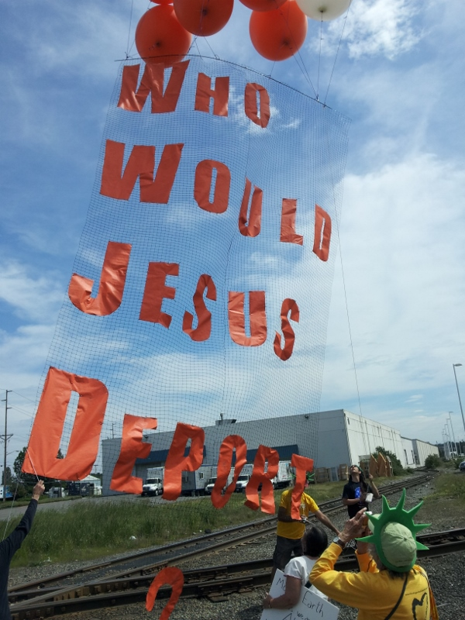
Tacoma Detention Center May 2012
Backbone Campaign

Slide 17
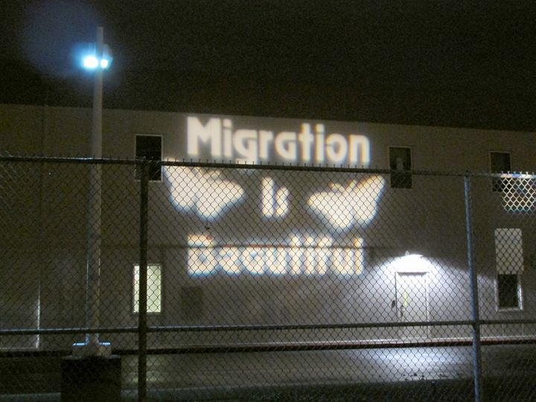
Backbone Campaign

Slide 18
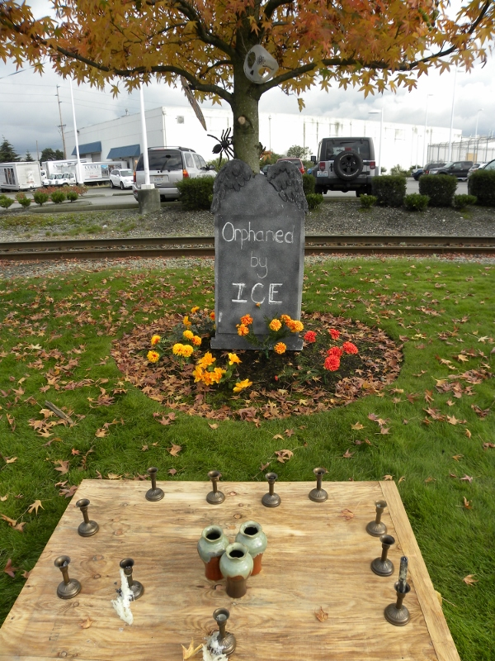
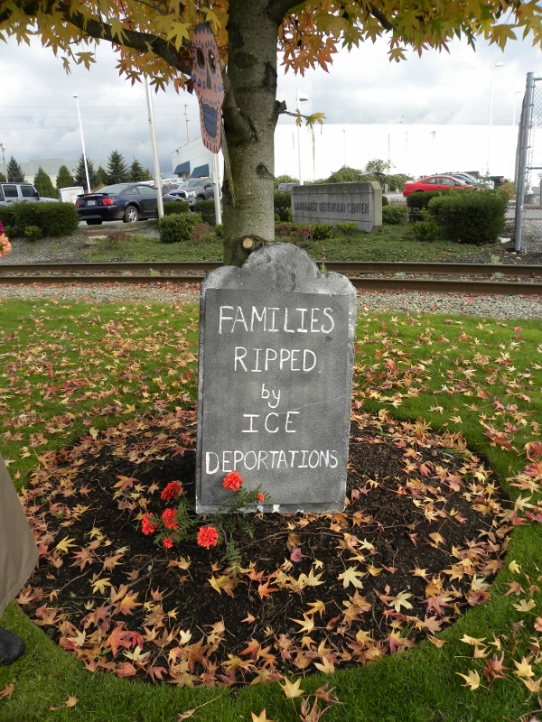
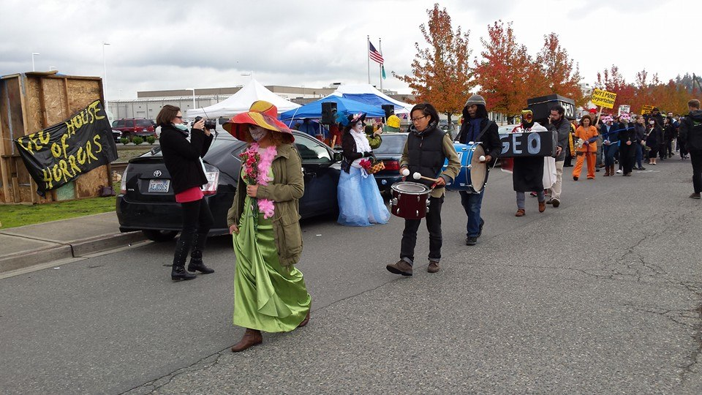
Day of the Dead protest at NWDC
La calavera catrina
Orphaned by IICE
Families Ripped by ICE deportation

Slide 19
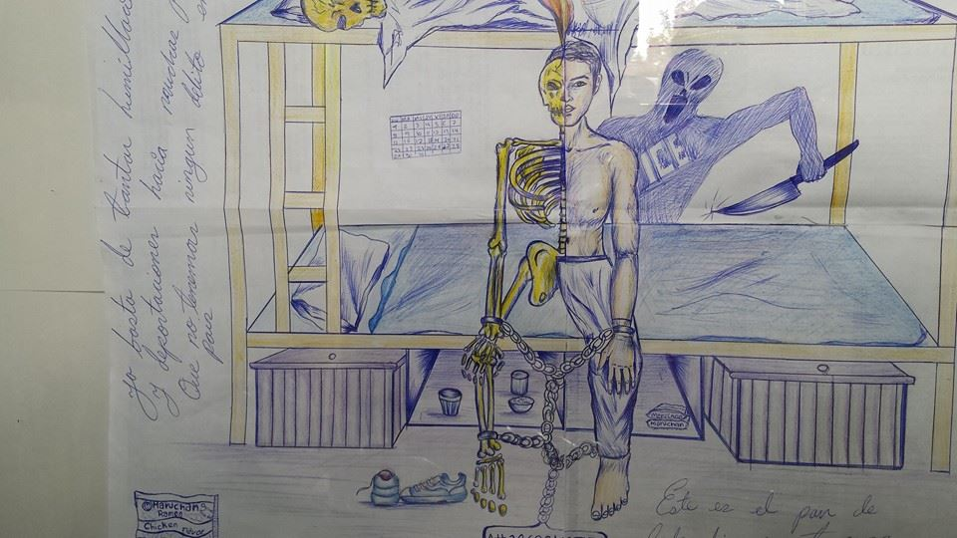
Drawing by Detainee Luis Rodriguez Arenival smuggled out by lawyer

Slide 20
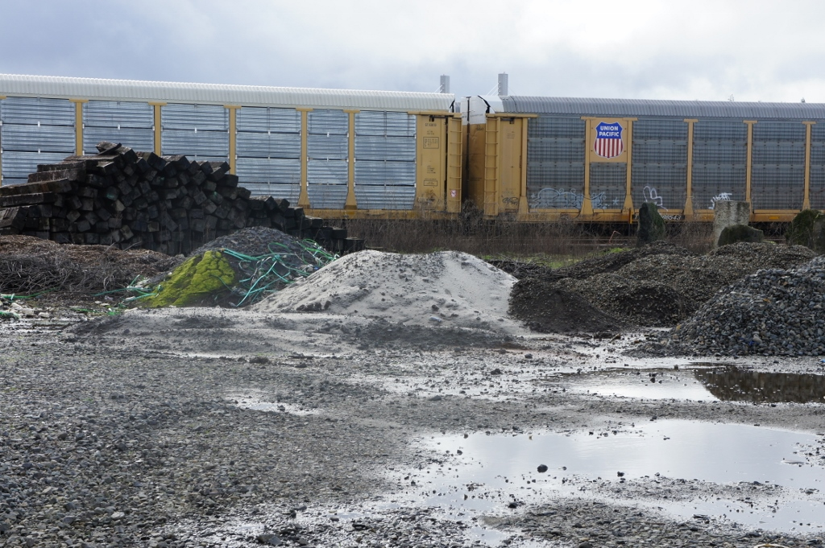
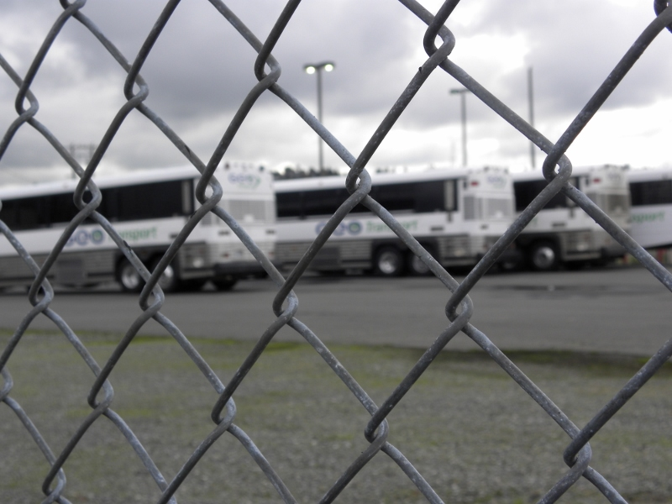
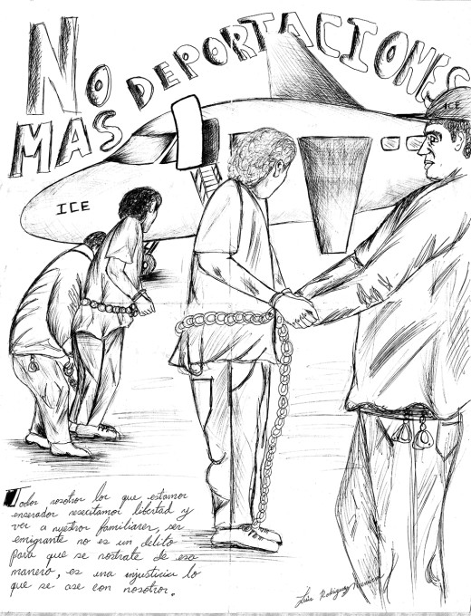
Drawing of deportation by
Luis Rodriguez Arenival

Slide 21
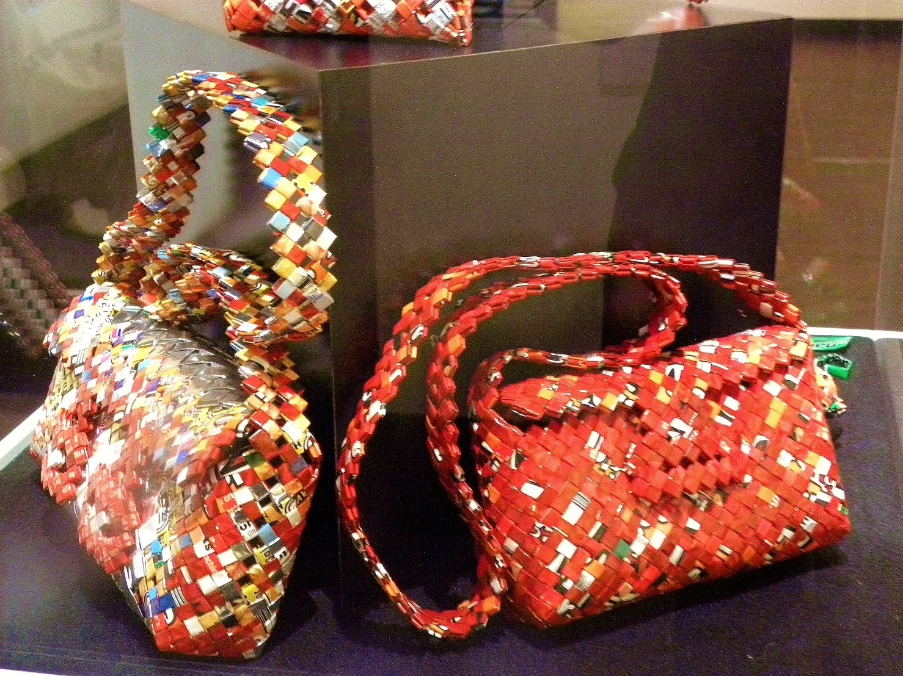
Pavel Bahmatov Detainee in Tacoma/Dalles
"Everything made here is mostly out of paper
or plastic, for instance I am making little shoes,
purses, jewelry boxes, picture frames and
more out of recycled paper and plastic.
I use plastic wrappers from candy,
ramen noodles, cookies,
anything really that we can get around here.
The silver colors is mostly inside of the chips
bags or candy bar wrappers.
Most of the things I make are woven together
and then sown with plastic string
that we make out of garbage bags.

Slide 22
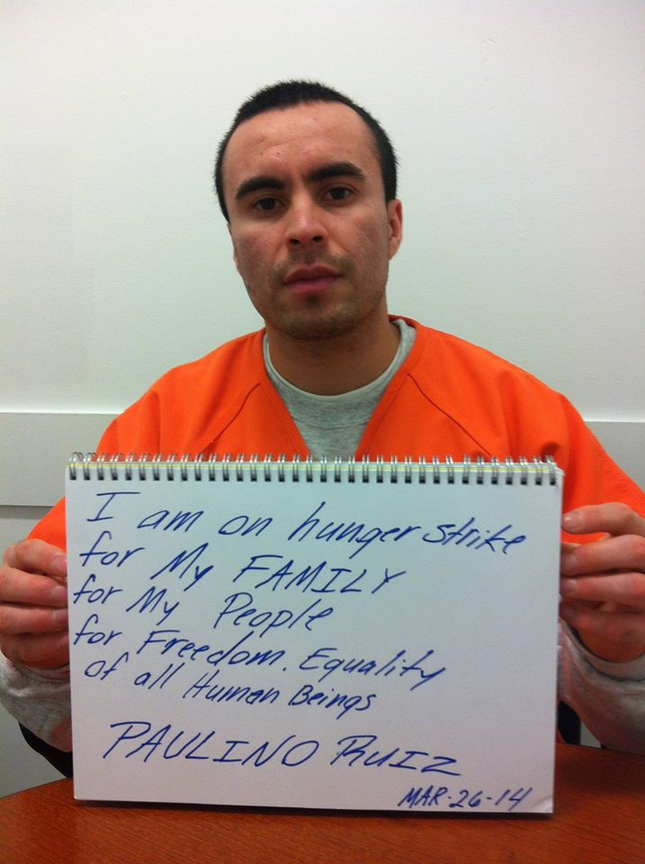
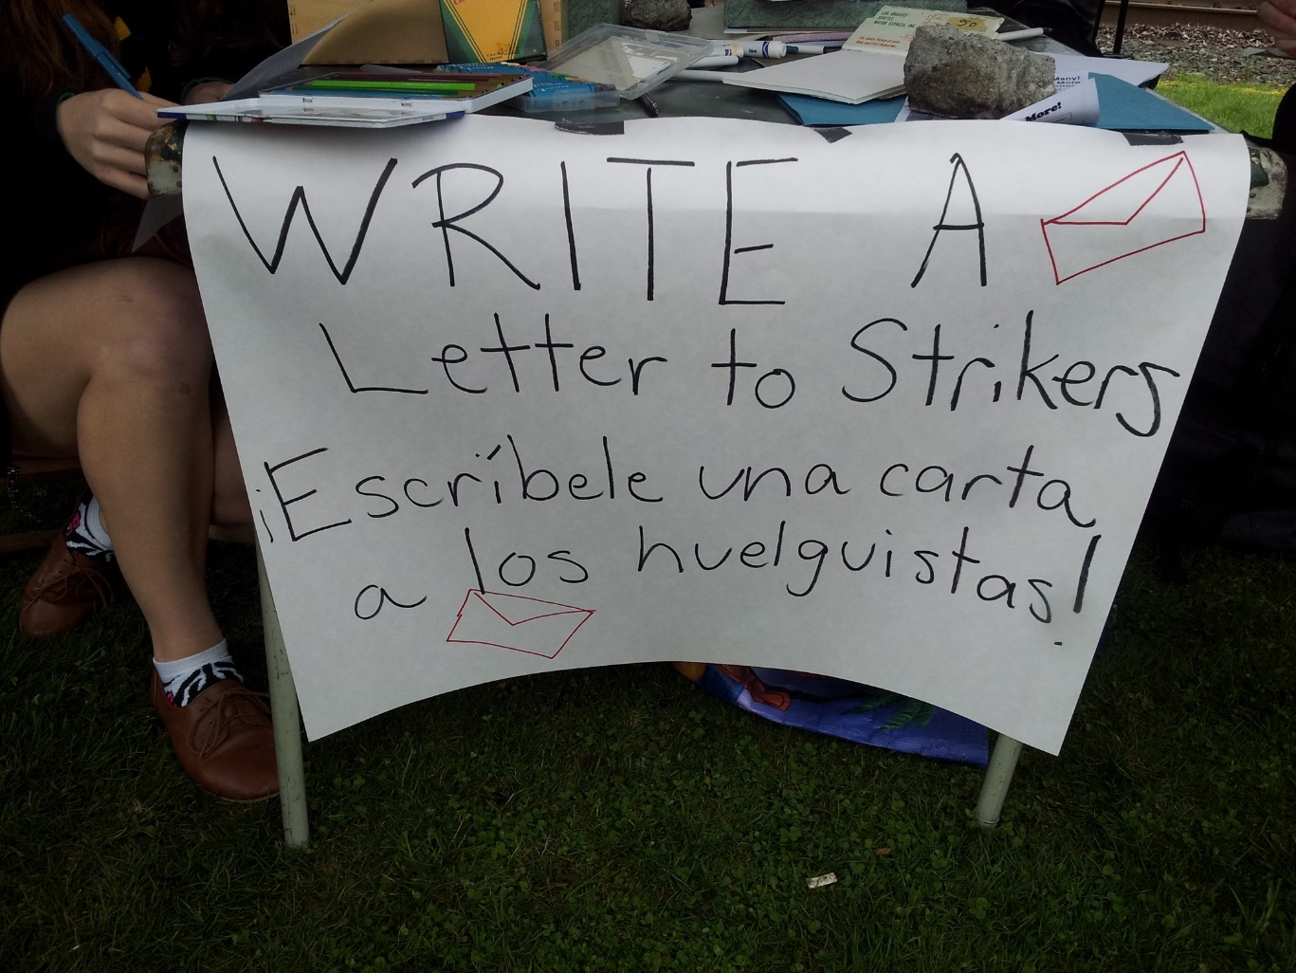

Slide 23
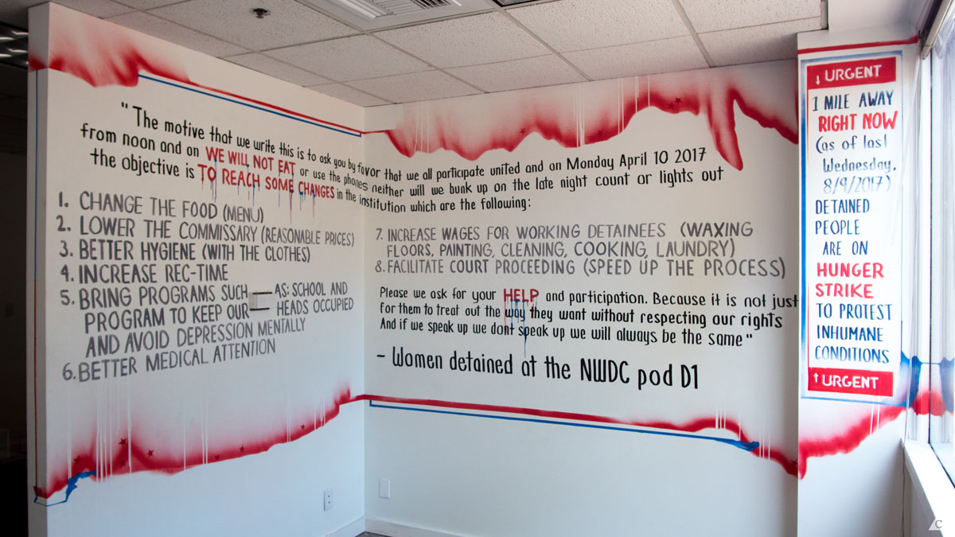
David Long Hunger Strikers Wall Painting
Spaceworks Gallery Summer 2017

Slide 24
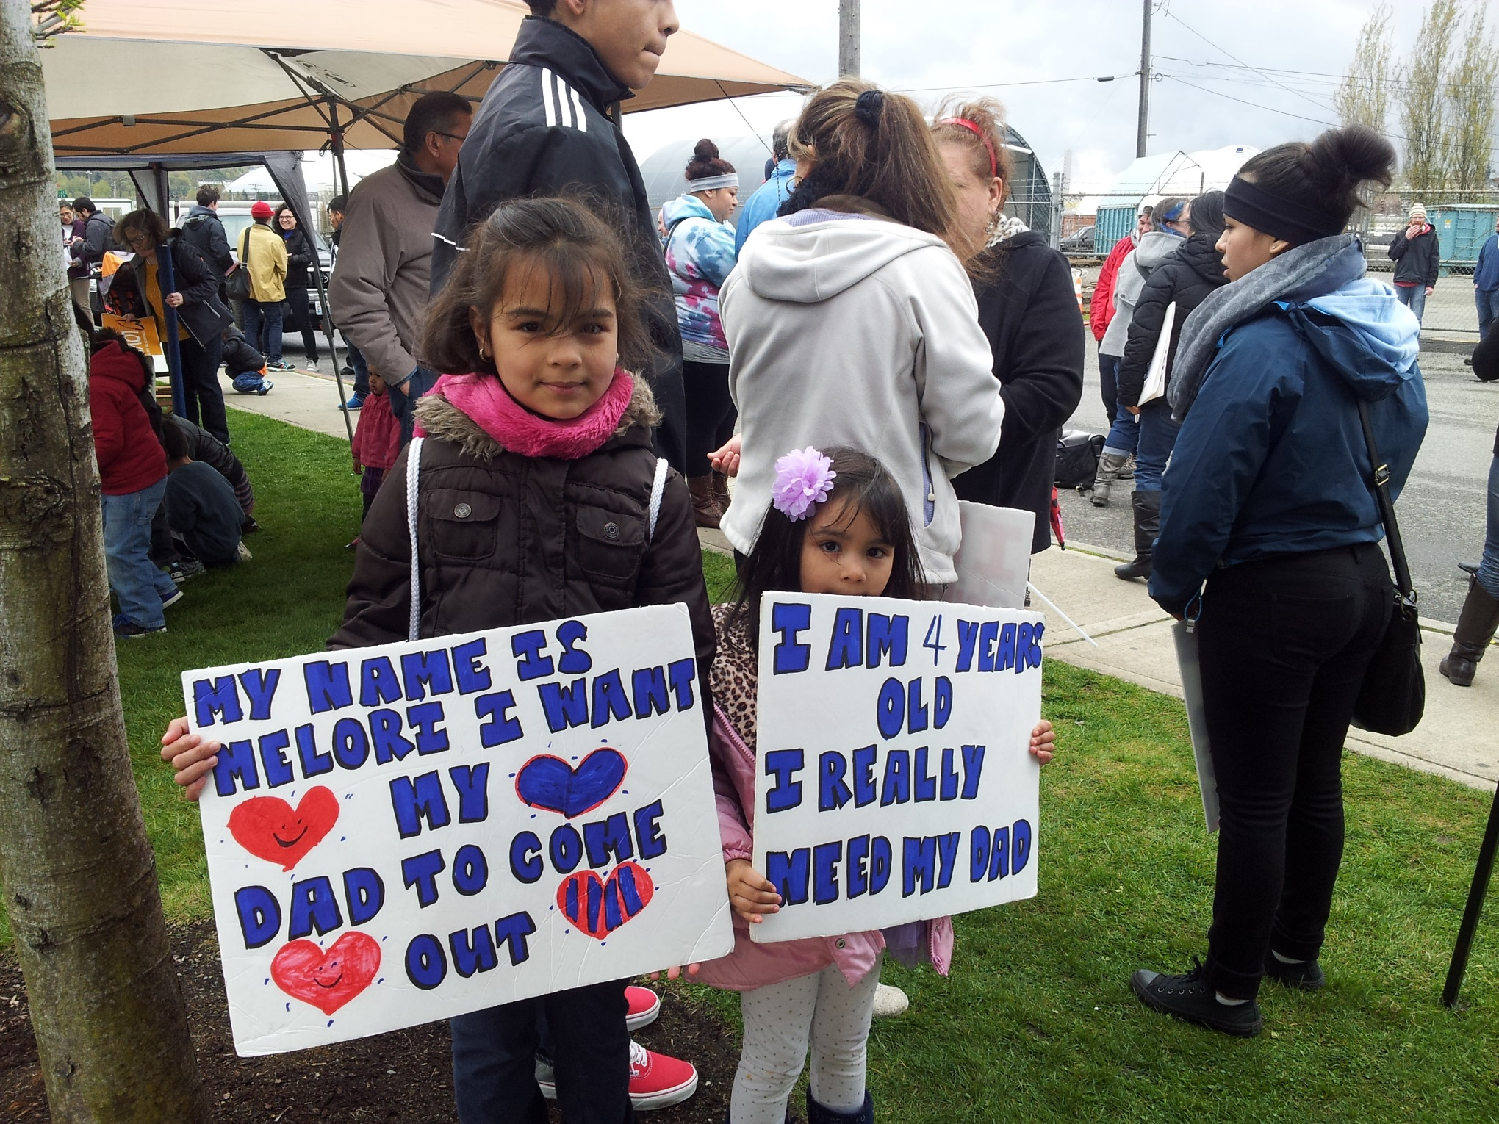

Slide 25
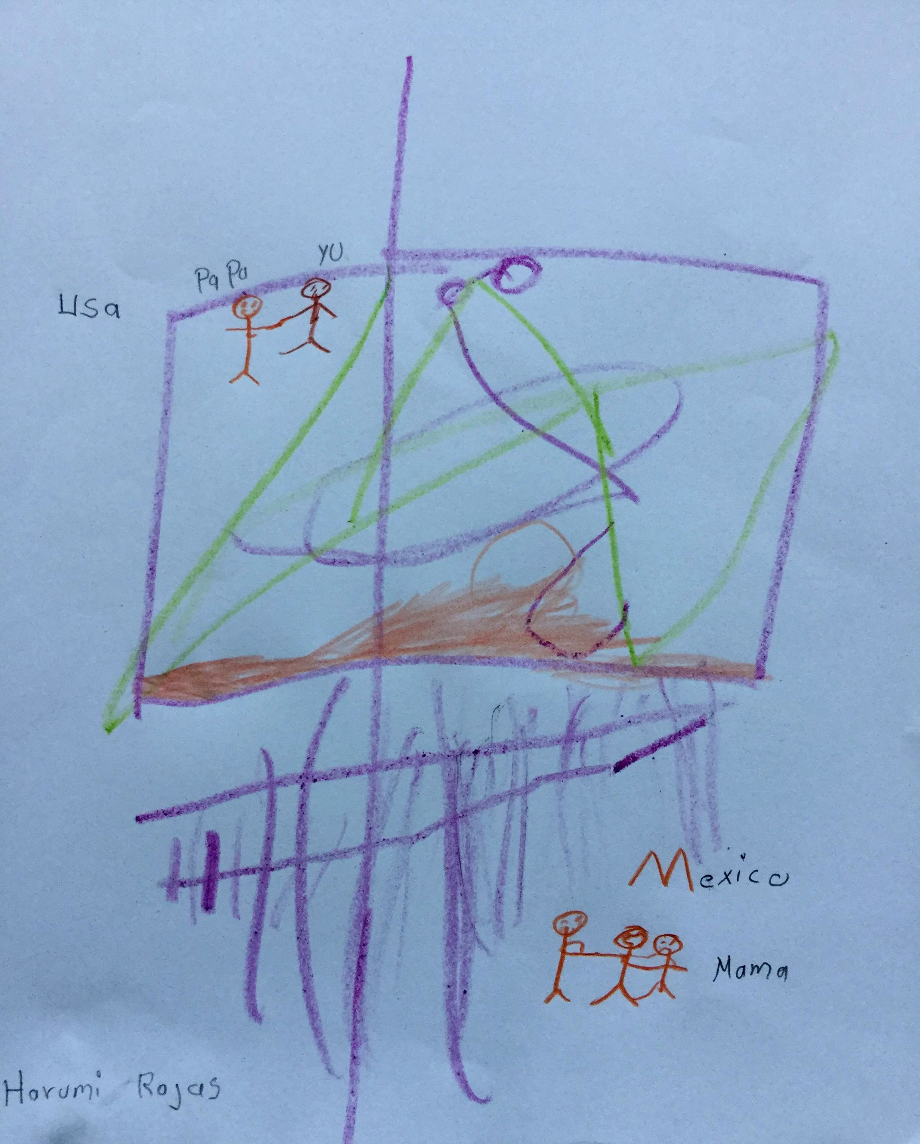
Child’s drawing of deported
mother

Slide 26
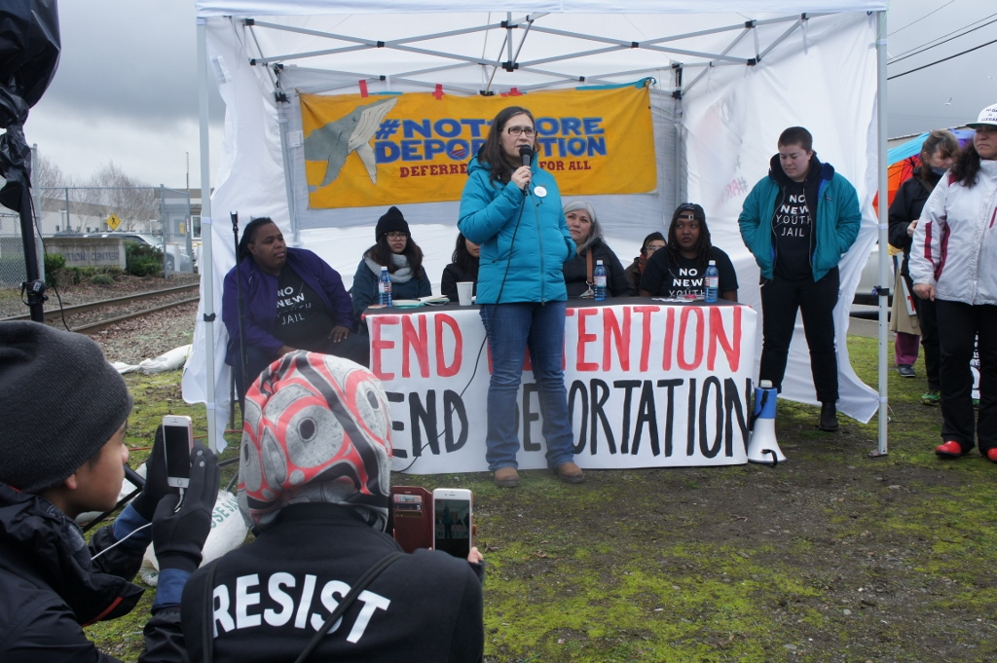
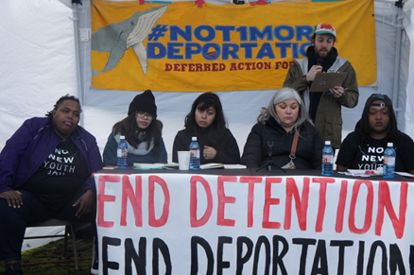
People’s Tribunal Feb 4, 2018 organized by
Northwest Detention Center Resistance
http://www.nwdcresistance.org/
Lead by Maru Mora Villalpando

Slide 27
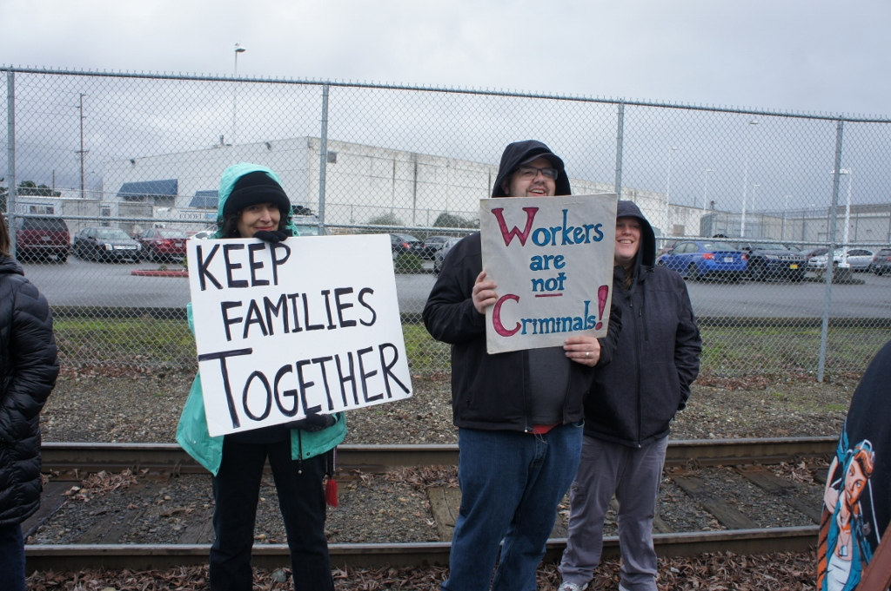
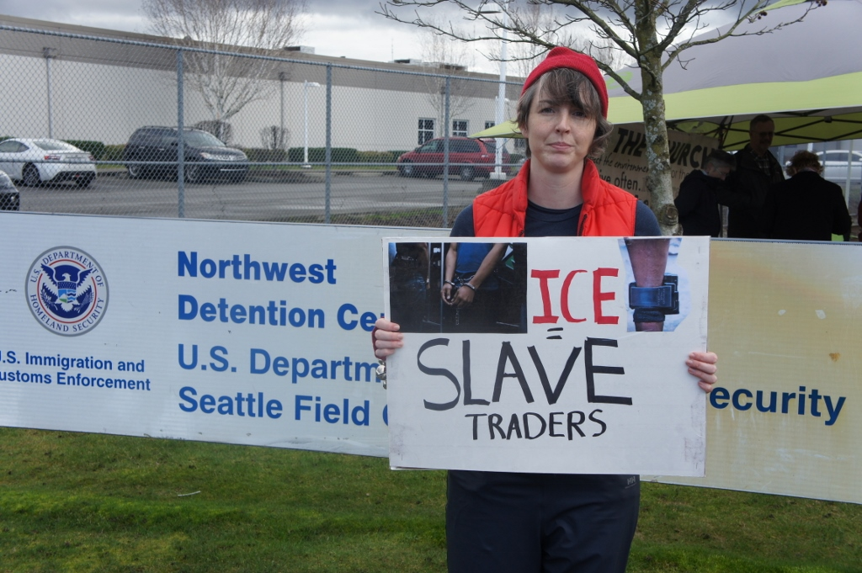
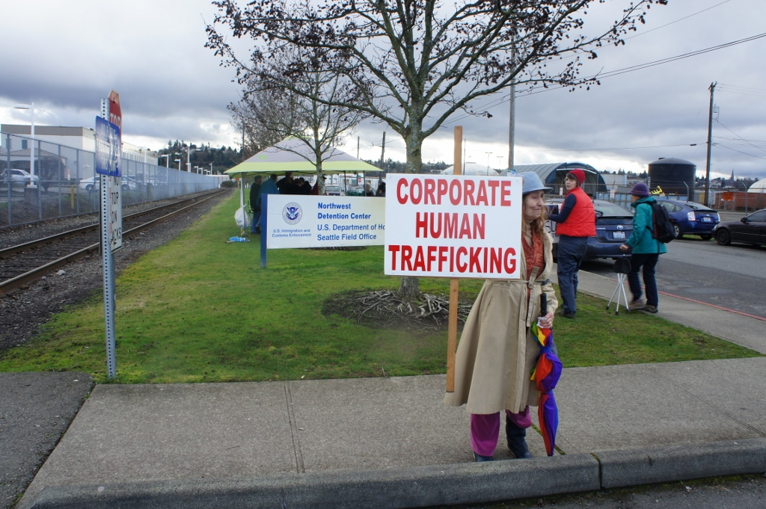

Slide 28
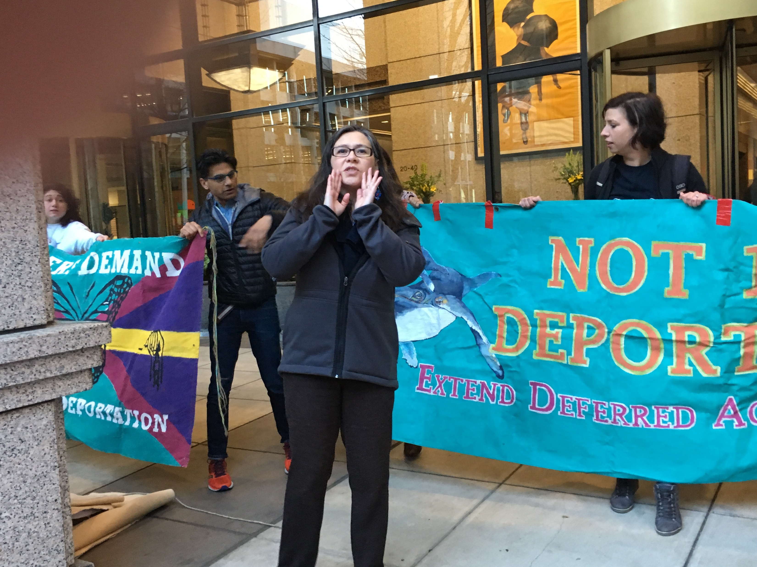
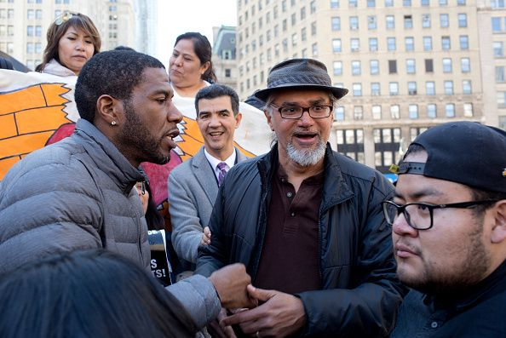
ICE policy now targets activists across the country
Maru Mora -Villalpando Seattle
Ravi Ragbir NYC

Slide 29
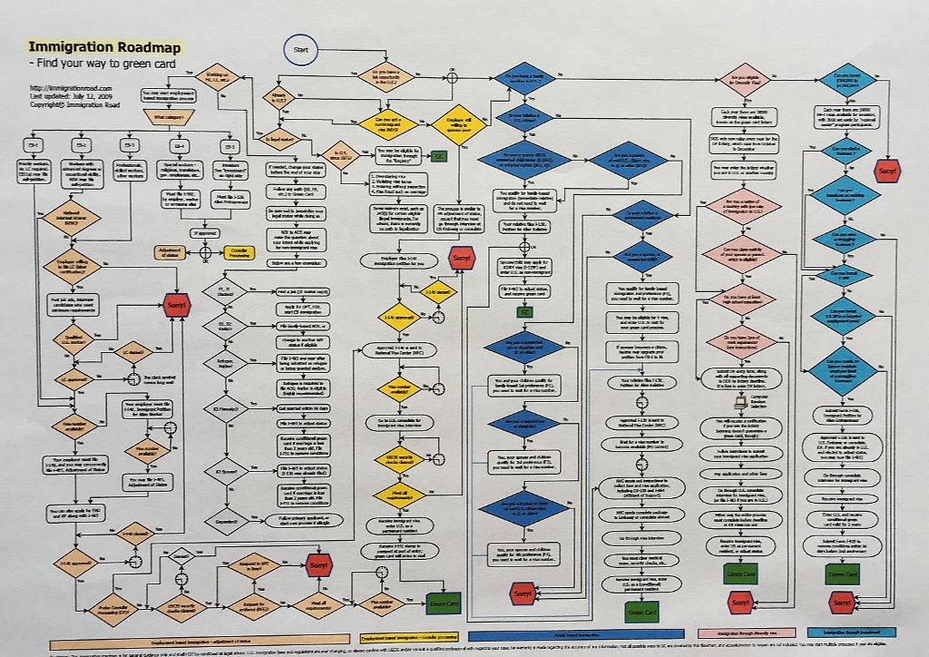
http://immigrationroad.com/
“Find your way to a green card”

Slide 30
Susan Noyes Platt www.artandpoliticsnow.com susplatt@gmail.com

